Slide 1
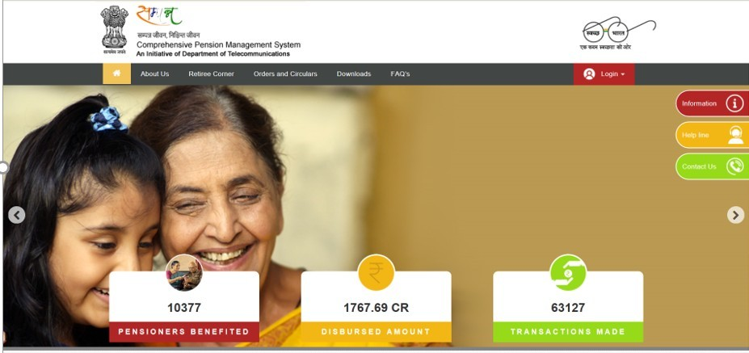


SAMPANN
Comprehensive Pension Management System
BSNL Voluntary Retirement Scheme 2019 via SAMPANN

Slide 2
Hierarchy of users in CPMS
Administrator
At DoT level
CCA
At CCA level
HoO
At BSNL Approver level
DH
Retiree
At BSNL level

Slide 3
User creation
User in CPMS terminology | User in BSNL | Method to create user
HoO (Head of Office) | As nominated by BSNL in SSA office | Send offline request to respective CCA for creation of their users by providing active mobile numbers
DH (Dealing Hand) | As nominated by BSNL | To be created in CPMS by HoO user
Please note that the user should change his/her password immediately after the first login

Slide 4
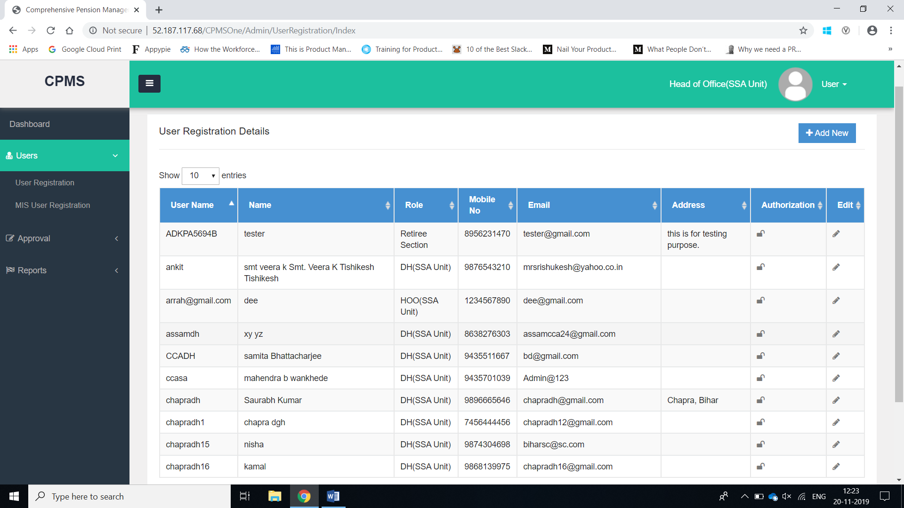
User Registered Details

Slide 5
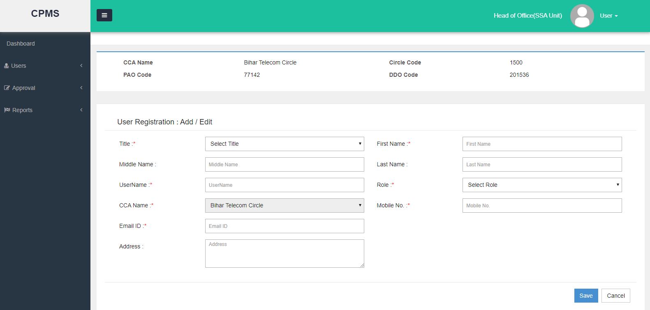
Creation of DH user

Slide 6
User Registered Details

Slide 7
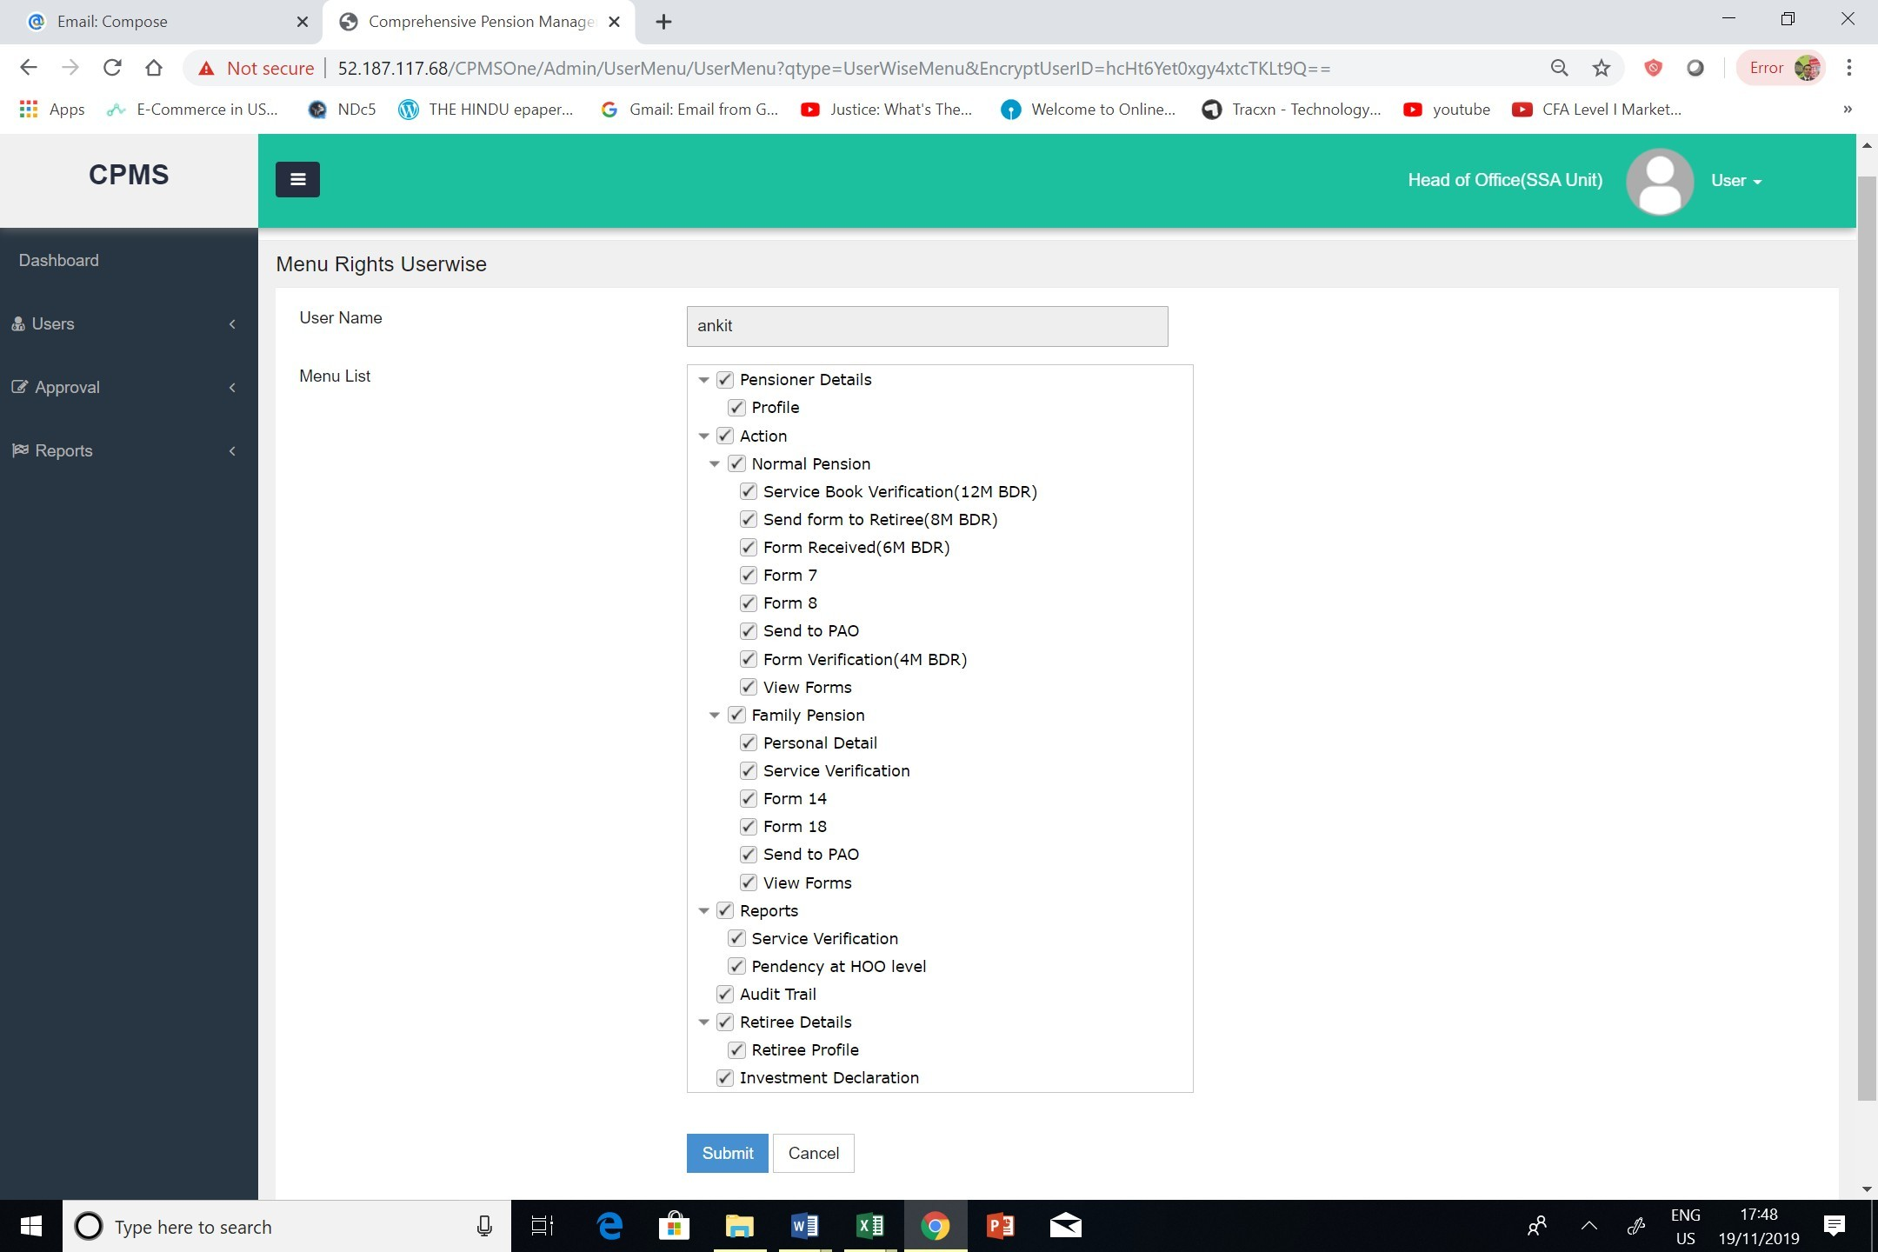
User Authorization
This is a mandatory step and must not be skipped

Slide 8
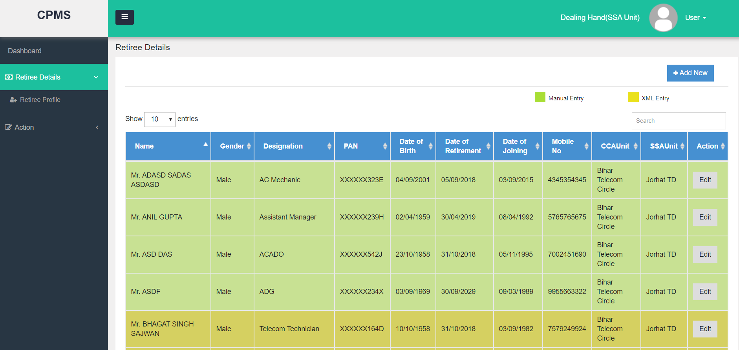
DH Inbox -List of Retirees
Notes:
In case of any discrepancy in data, the concerned CCA office must be contacted
In case of a transfer, the concerned CCA office must be contacted
In case any retiree is missing from the data, the concerned CCA office must be contacted

Slide 9
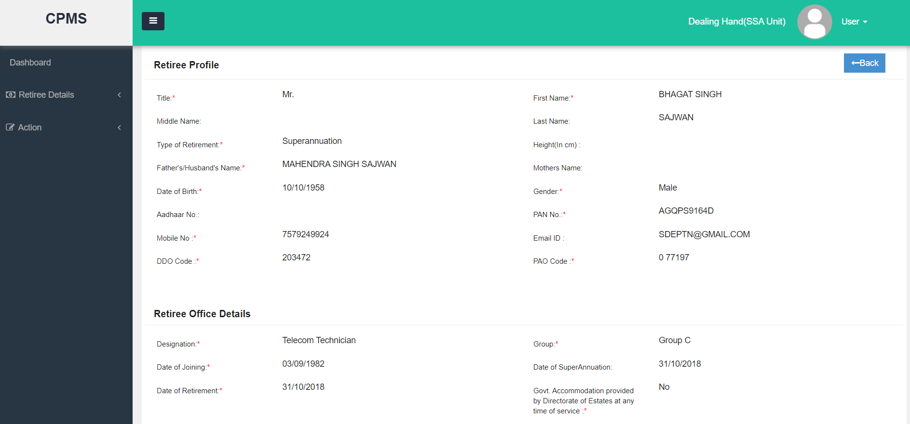
View Retiree Details
Discrepancy in data must be immediately informed to respective CCA office
Mobile number being entered should be an active number
Notes:
Data should be thoroughly checked. If there is any discrepancy, the concerned CCA office must be informed.

Slide 10
Collection & Submission of Pension Papers
Step 1
Service Book Verification
Step 2
Form Received
Step 3
Form 7
Step 4
Send to PAO

Slide 11
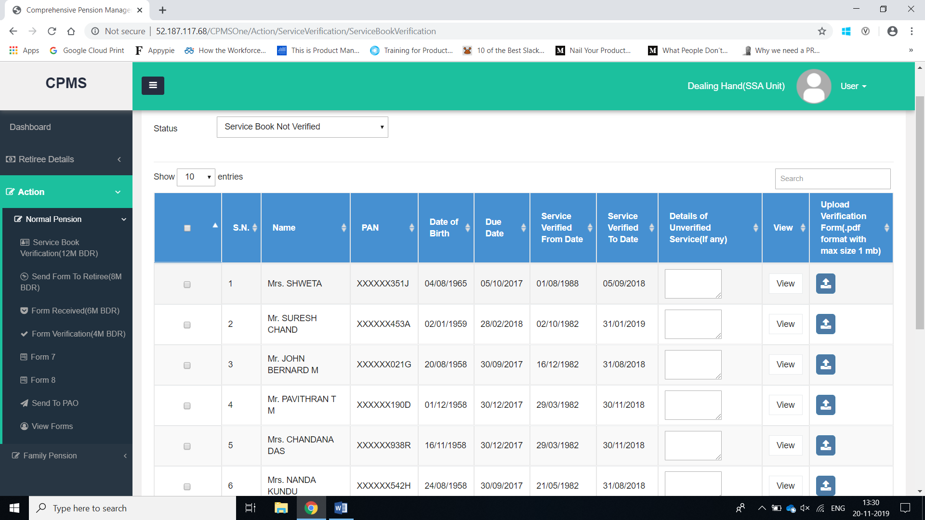
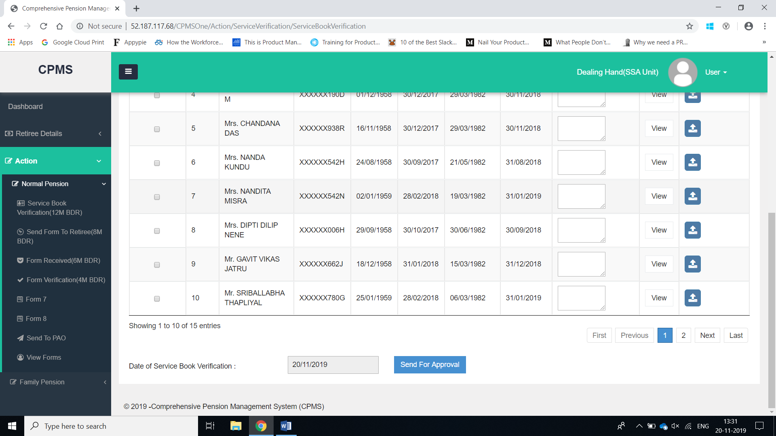
Step 1 – Service Book Verification
As a best practice, to save time, DH should send cases in batches for approval.
Search Keys
Action buttons
As it is ERP based, no view has been given.
Notes:
S/B should be complete. Errors in S/B / Shortcomings in Service book should be circulated by CCAs as well.
Complete this activity diligently. If some period is missing, go ahead with the process after mentioning.

Slide 12
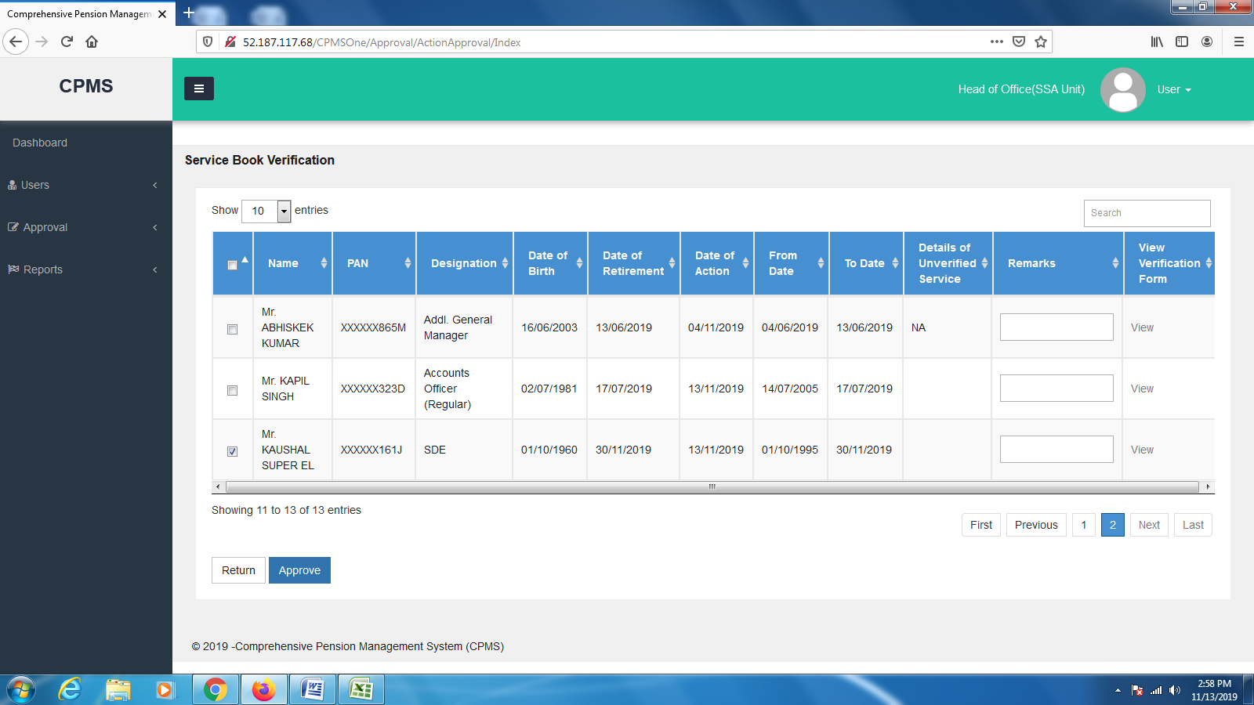
Step 1(a) – Service Book Approval
As it is ERP based, no view has been given.
Notes:
As a best practice, mulitple cases should be selected at a time and processed in batches to save time. This step should be completed within the first week.

Slide 13
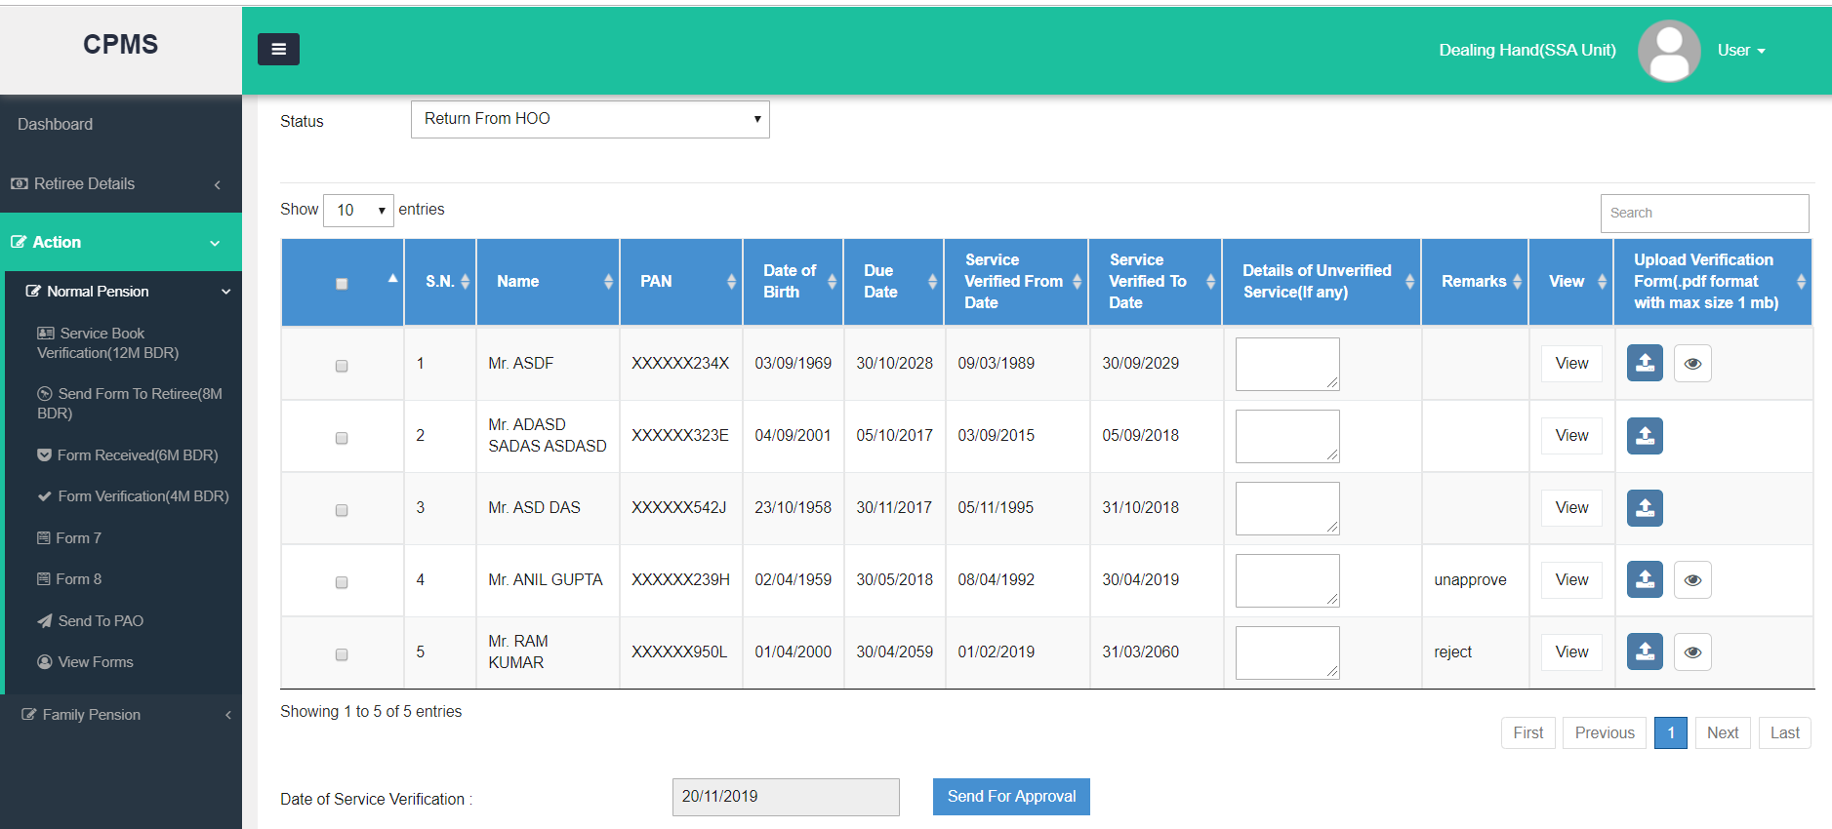
Step 1(b) – Service Book Return from HoO
As it is ERP based, no view has been given.

Slide 14
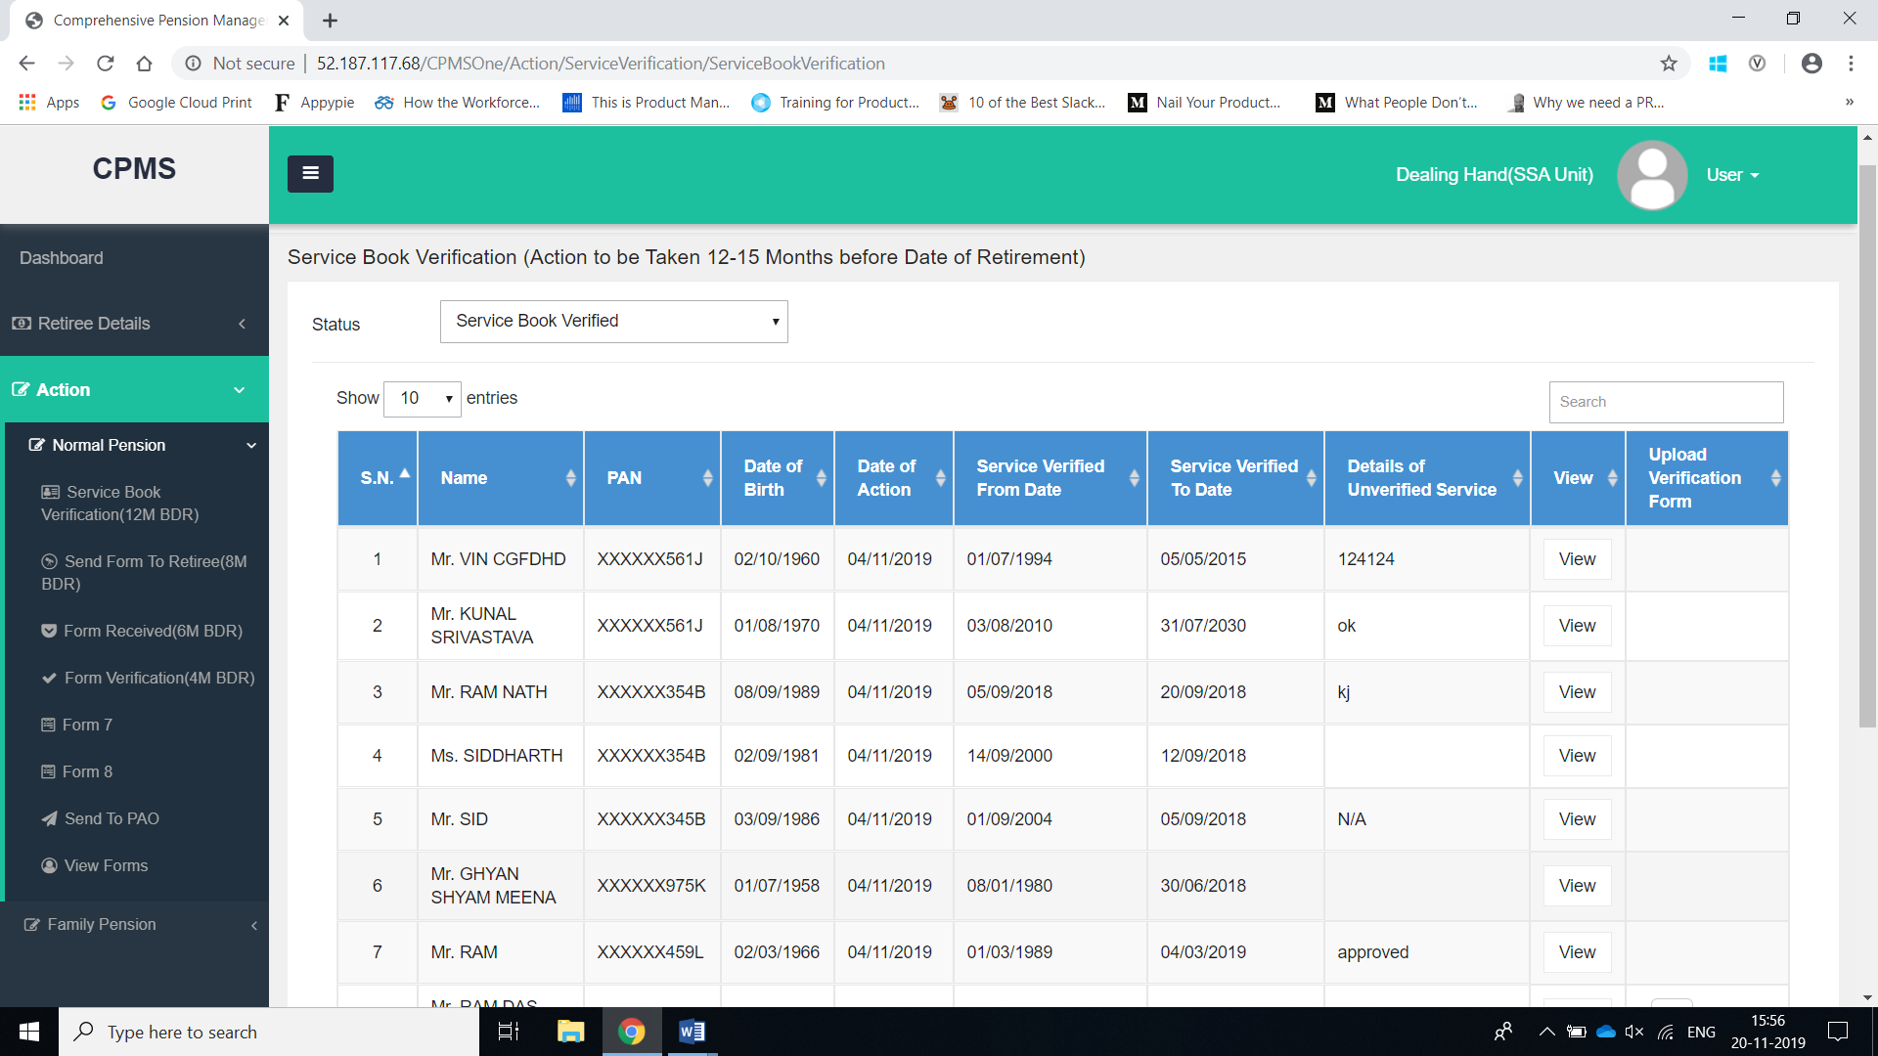
Step 1(c) – Service Book Verified

Slide 15
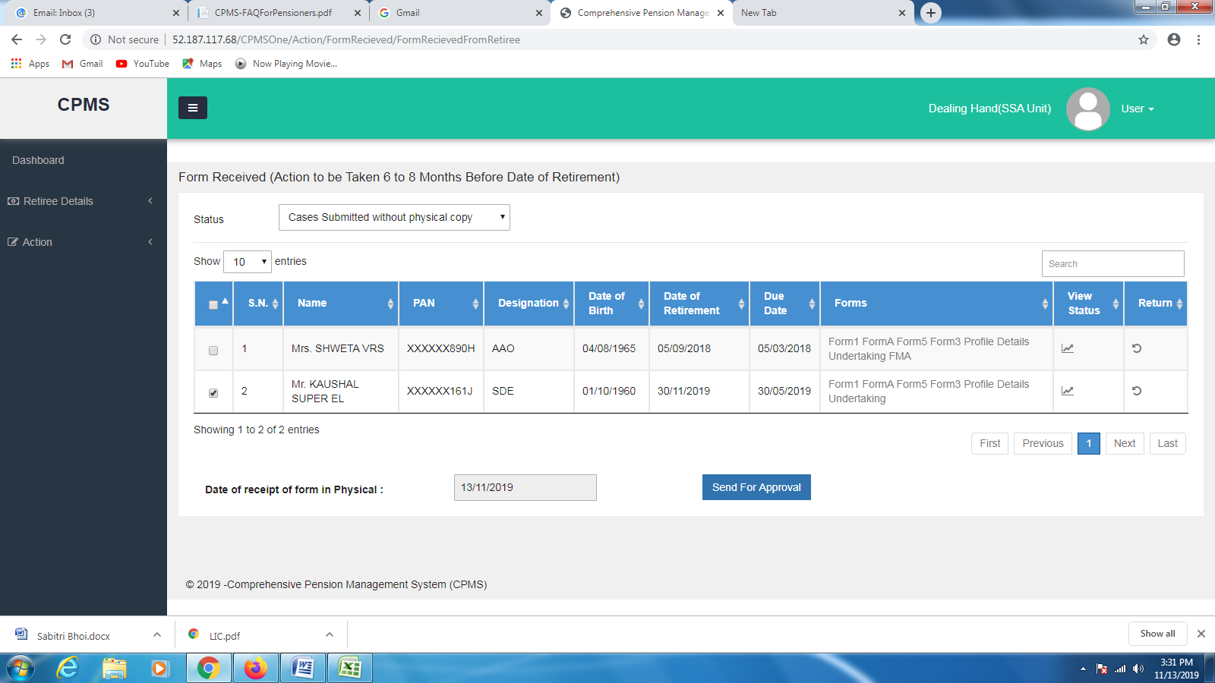
Step 2 – Physical Forms Received

Slide 16
Step 2 (a) – Physical forms received
Following details must be checked against the documents submitted by the Pensioner with utmost care:
  Photographs uploaded (Single and Joint) should be of good quality and clear.
  Signature should legible and visible clearly
  Address can only have alphanumeric characters and no special characters should be entered. Instead space should be used if needed.
  Bank Account Details should match the mandate form submitted by the retiree
  Family member name and Details (DoB/Marital Status) should be verified with Service Book.
Notes:
Wait for hard copy. Overwriting to be avoided in all cases. And each over-writing has to be either updated in software by returning to the pensioner. Check all hardcopies and softcopies with focus on above.

Slide 17
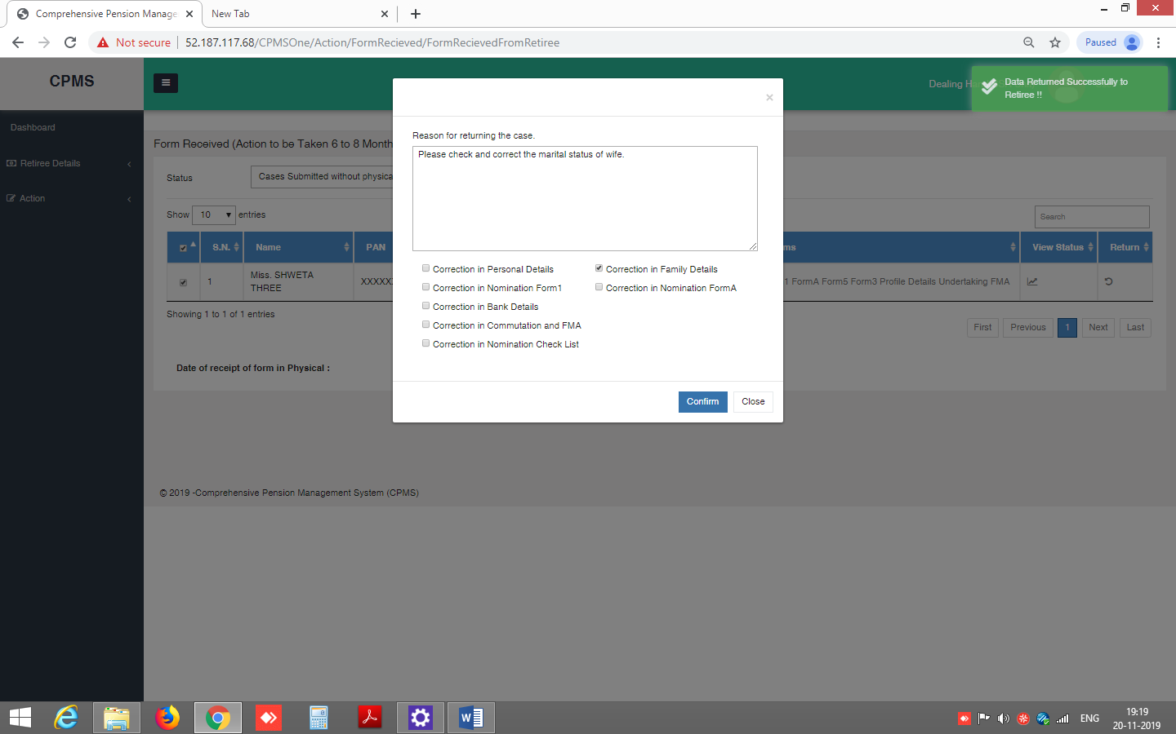
Step 2(b) – Return - Forms Received
DH should also intimate the pensioner regarding this.

Slide 18
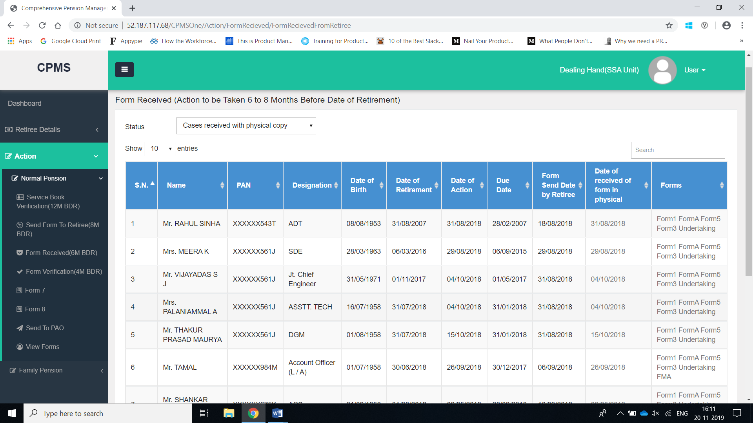
Step 2(c) – Physical Forms Received

Slide 19
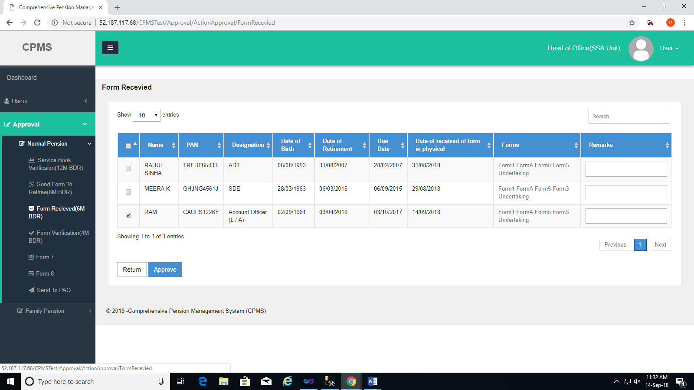
Step 2(d) – Approval of Physical Forms Received

Slide 20
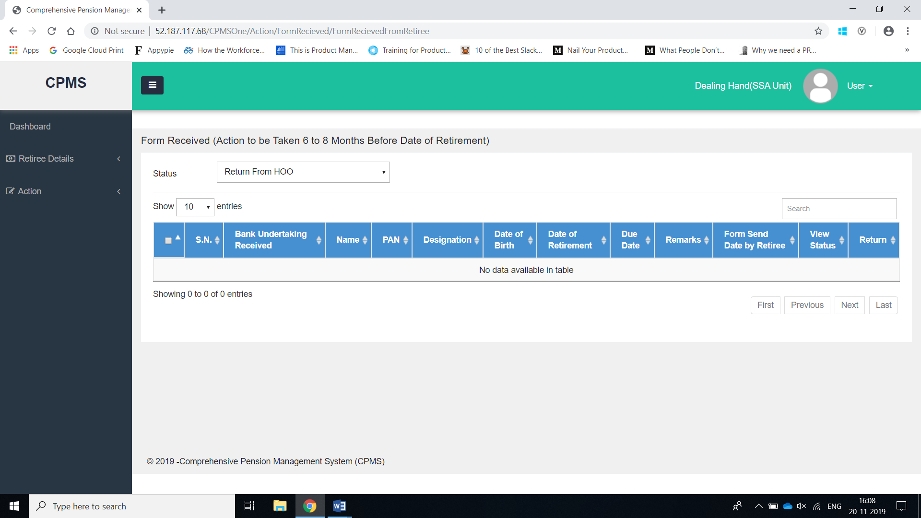
Step 2(e) – Return from HoO

Slide 21
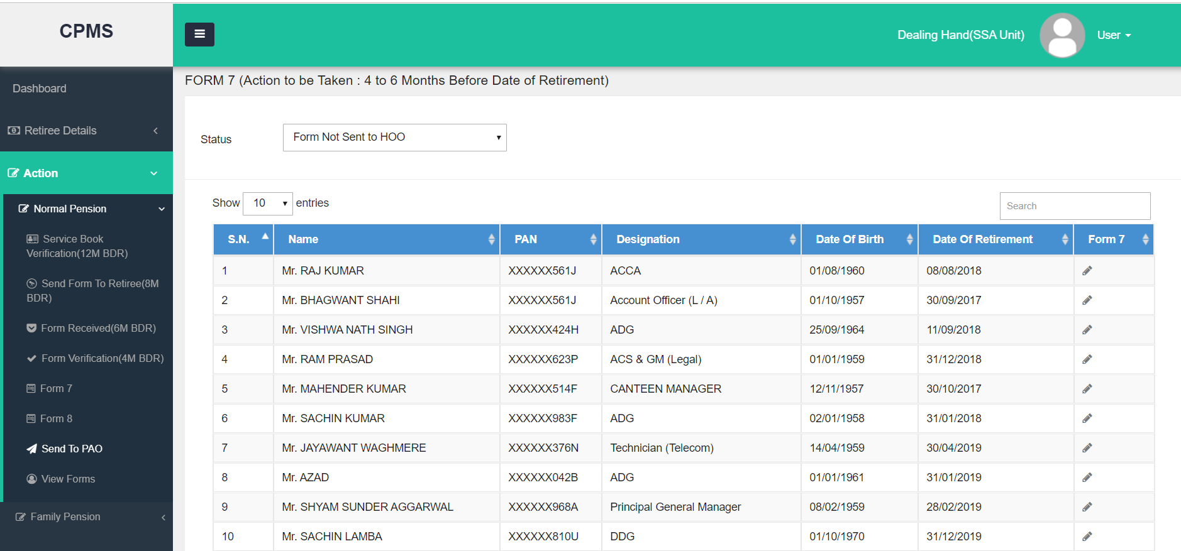
Step 3 – Verify & fill Form 7

Slide 22
Step 3(a) – Verify & fill Form 7
All the following calculation fields must be given due diligence while filling in the details:
  Pay Scale
  Qualifying/Non Qualifying service
  Additional Qualifying service
  average emoluments
For Retirement Gratuity and Commutation, it shall be mentioned that they are deferred and as per BSNL Voluntary Retirement Scheme 2019.

Slide 23
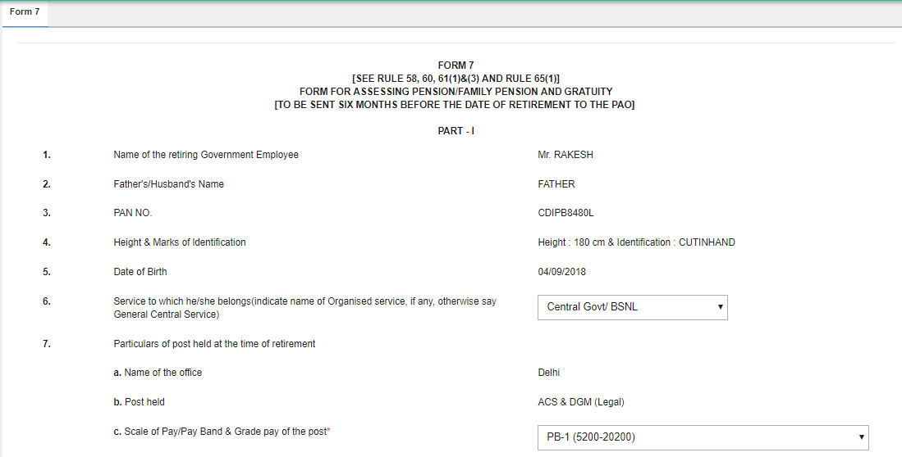
Step 3(b) – Verify & fill Form 7

Slide 24
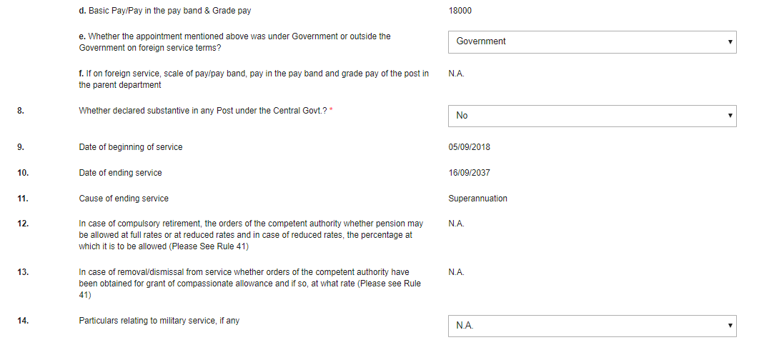
Step 3(c) – Verify & fill Form 7

Slide 25
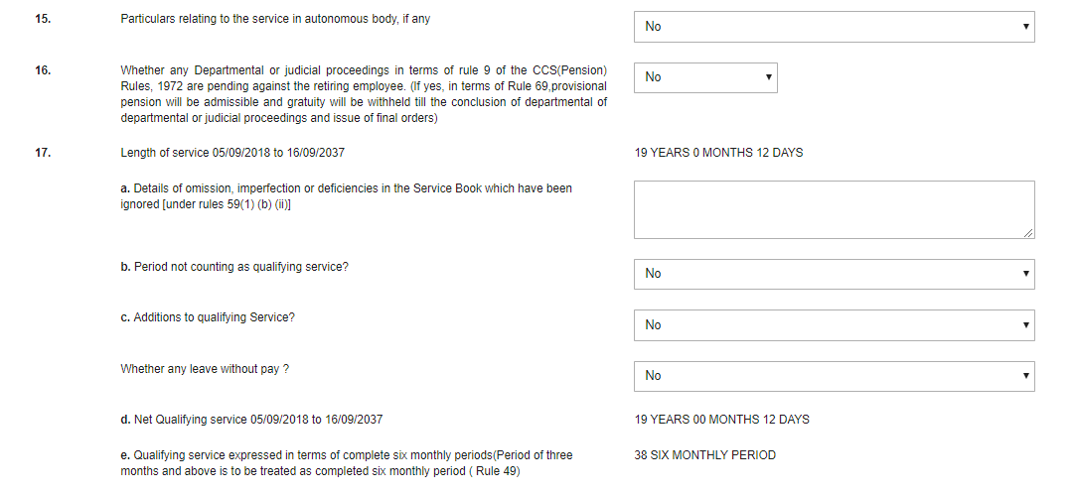
Step 3(d) – Verify & fill Form 7

Slide 26
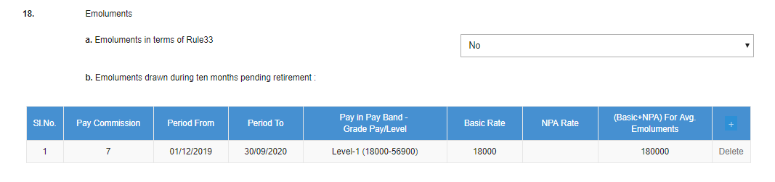
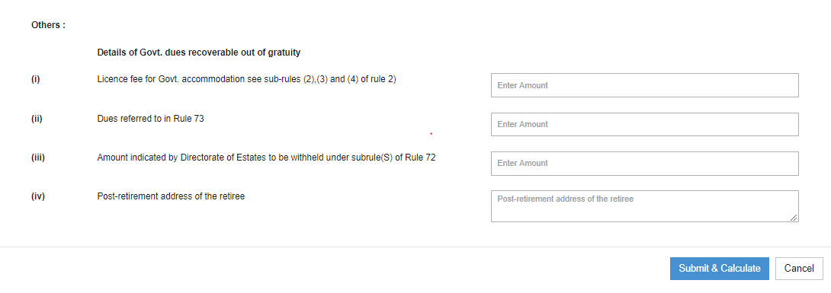
Step 3(e) – Verify & fill Form 7
Notes:
For any clarity and issue, get in touch with concerned CCA office.

Slide 27
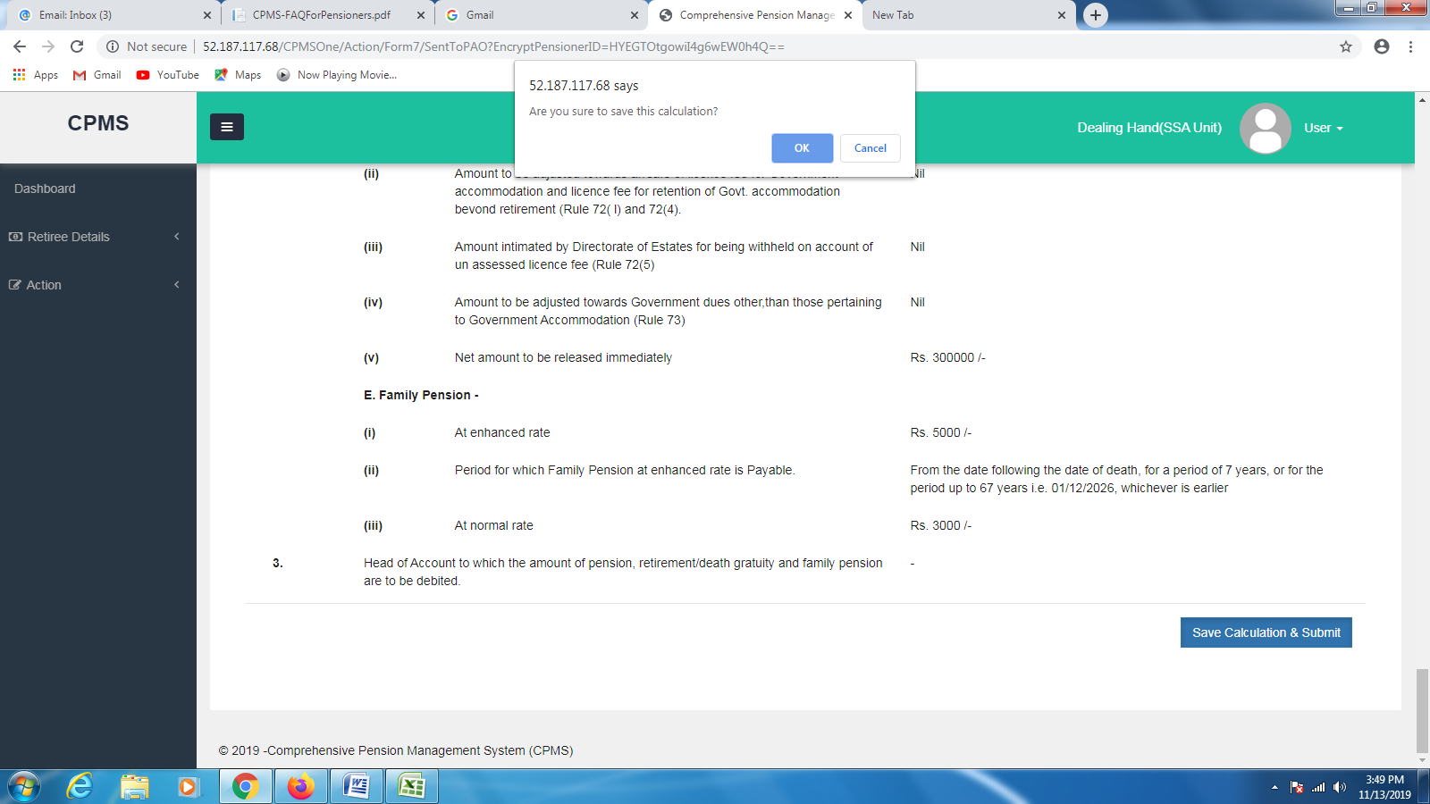
Step 3(f) – Save Calculation and Submit

Slide 28
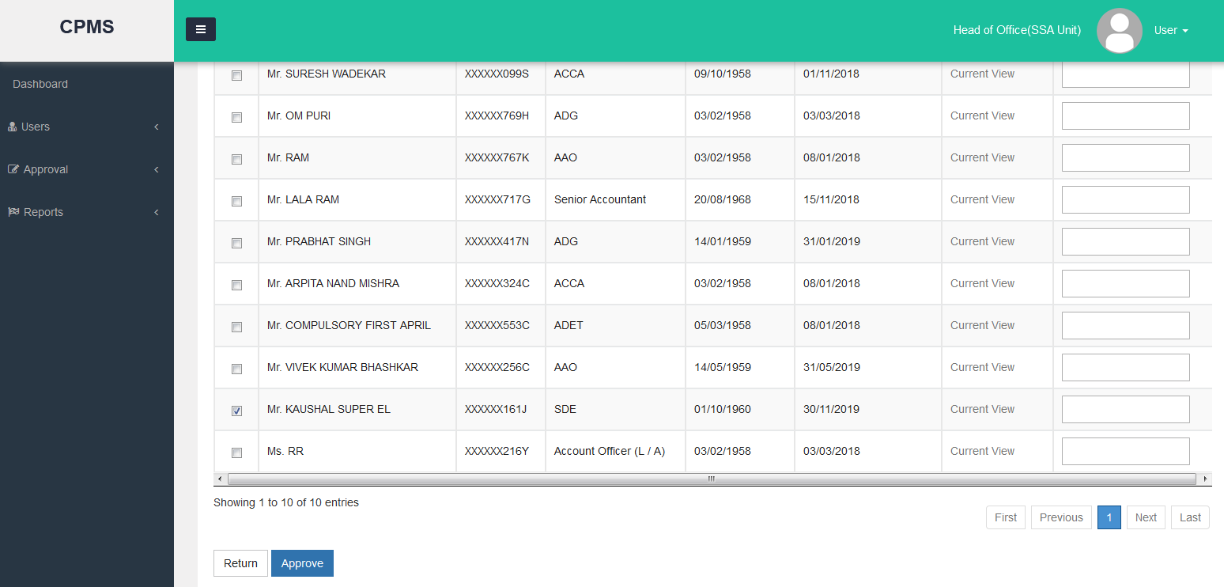
Step 3(g) – Approval of Form 7

Slide 29
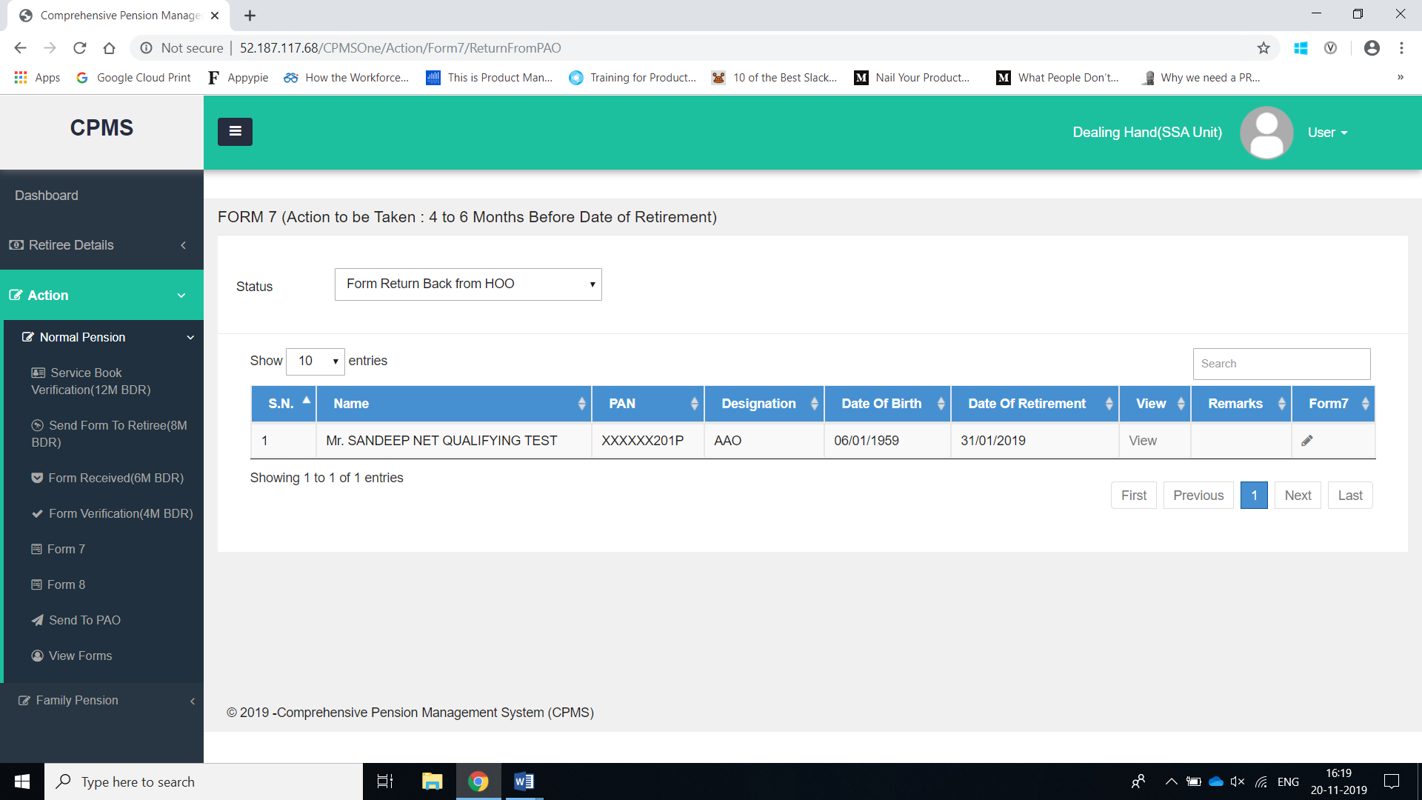
Step 3(h) – Return From HoO

Slide 30
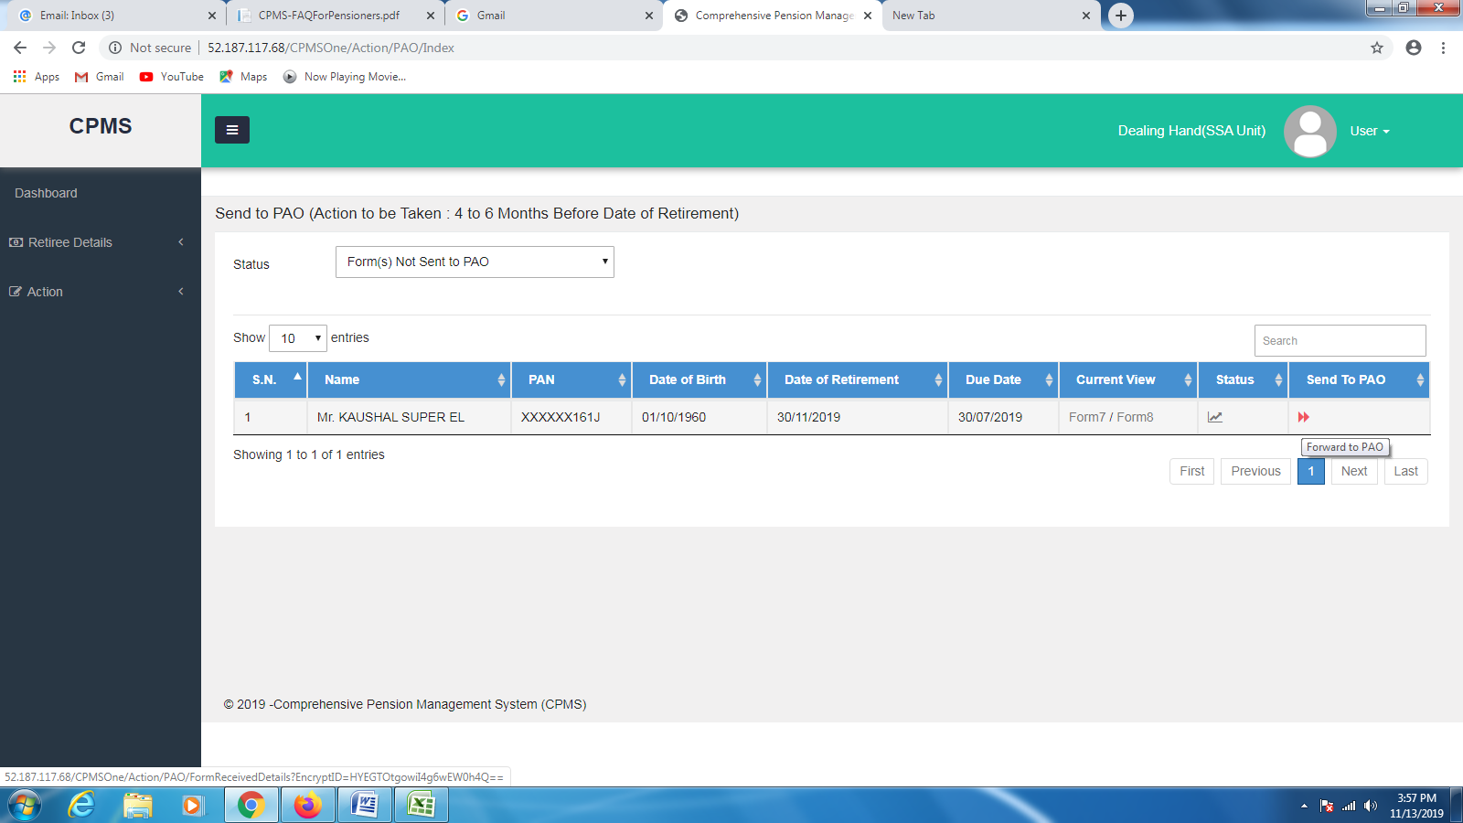
Step 4 – Forward to PAO

Slide 31
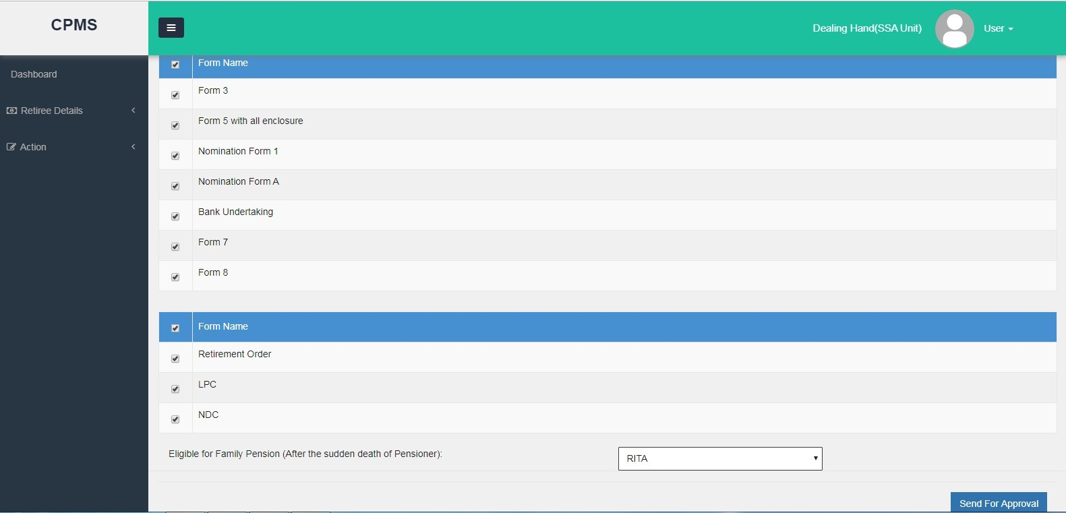
Step 4(a) – Forward to PAO
Due diligence should be made while selecting person eligible for family pension from the list of family members

Slide 32
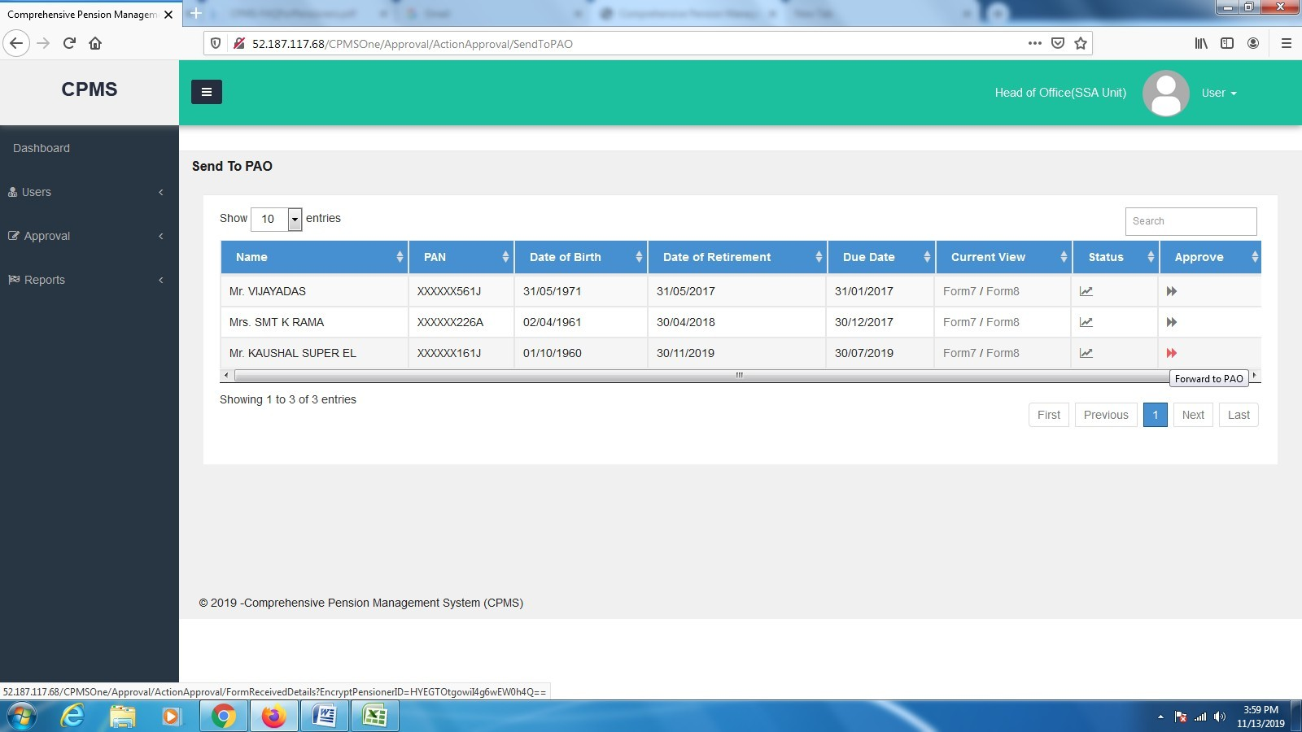
Step 4(b) – Send to PAO Approval

Slide 33
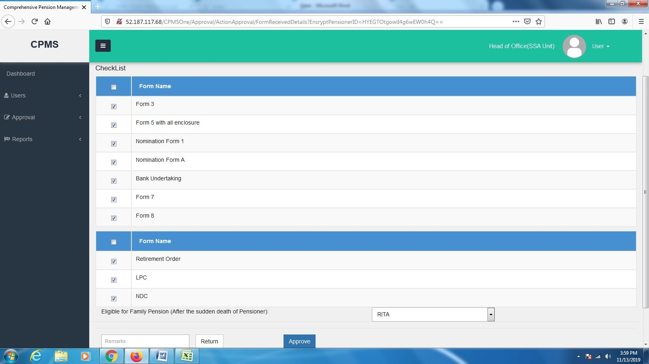
Step 4(c) – Send to PAO Approval
Notes:
Make sure nothing is left out in check list. Maintain the sheet wherein each page is numbered. Special attention on Eligible Family Pensioner.
Please send a mail as well to CCAs in which list of cases that are being sent by HoO and date of dispatch is mentioned so that CCA office may accordingly prepare.
CCA office may also get forms initiated in smaller offices to achieve onboarding.

Slide 34
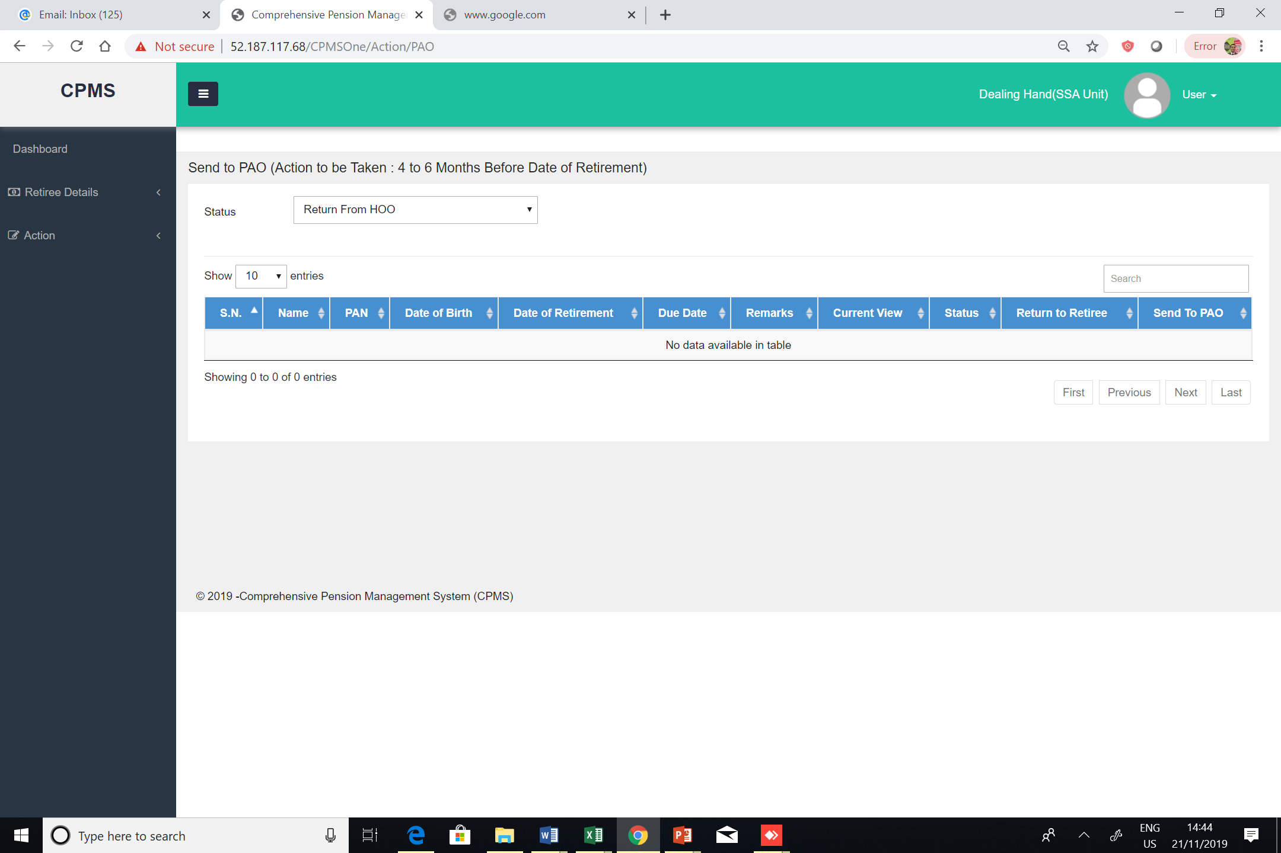
Step 4(d) – Return From HoO

Slide 35
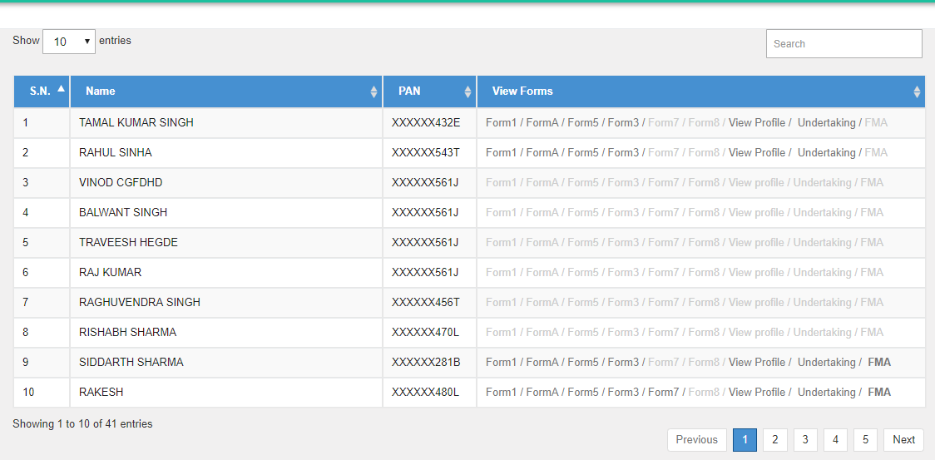
View Forms

Slide 36
Other points of importance
1. User creation and intimation
----for HoO by CCA(nomenclature based)-
----for DH by HoO(nomenclature based)-
2. Edit/delete and transfer module for CCA and Administrator
Exact Number of Pensioners SSA/office wise- Name, HRMS number, Mobile Number.
MIS reports for Head of office and CCA offices for monitoring
Creation of helpline and resolution SSA>>CCA>> DoT-A/c

Slide 37
Thanks
https://dotpension.gov.in/Login/Index

